Slide 1


Propensity Scores
John Seeger, PharmD, DrPH
Chief Scientific Officer, Optum Epidemiology
Adjunct Assistant Professor, Harvard School of Public Health

Slide 2
Roadmap
Journal Club: Revascularization and Mortality
  Articulate principles in context of example
Case Study: Statins and Myocardial Infarction
  Introduce problem behind dataset
SAS work: Statins and Myocardial Infarction
  Work with example to illustrate concepts

Slide 3
Does treatment A lead to different outcomes than treatment B?
How?
Case Report
  Patient #1 received treatment A, had outcome X
Time machine
Random allocation
Observationally
  Propensity Scores
Outcome
X
Y
A
A
B
Treatment
B
C
D

Slide 4
Random Allocation
Balances compared groups (in expectation)
Lends formal meaning to p-values
Makes placebo group practical
Includes features to strengthen inference
  Baseline measures
  Adherence
  Monitoring parameters
  Standardized outcome measures

Slide 5
Despite Strengths, RCTs Have Limitations
External validity
  Selection criteria
  Practice settings
  Practice patterns
Pragmatic RCTs as partial solution
  Baseline Randomization
  Observational/hybrid follow-up
  May remain cost/time/feasibility-prohibitive
Observational design/propensity score

Slide 6
Imbalance among treatments
EXPLICIT
Indication
Subtype of indication
Severity of illness
Concomitant illness(es)
Concomitant medications
Contraindications
IMPLICIT
“Medicalization”
MD training/experience
Regional treatment patterns
Others?
C
Severity
Prognosis
Comorbidity
Randomization
Treatment
Outcome

Slide 7
Propensity scores in a sentence
A patient’s propensity to be treated (propensity score) is his predicted probability of treatment, given his characteristics (everything that is known about him).
A few observations:
  A propensity score is a number (a probability), so…
  A propensity score can range from 0 to 1 (inclusive)
  A propensity score is predicted (more later)
  A propensity score depends on what is known…

Slide 8
What does this mean?
Confounders
If we can remove the confounder -> treatment arrow, we can remove confounding
Patients with equivalent probabilities of treatment will have no confounder -> treatment association
Treatment
Outcome

Slide 9
The rest is details
What would it take to have a fair (balanced) comparison?
  Balance on one confounder
  Balance on all confounders
How to achieve?
  Restrict, adjust, match, stratify, weight, (randomize?)
What is a balancing score?
What does balance look like?

Slide 10
What is the Propensity Score?
Predicted probability of receiving treatment A relative to treatment B
Estimate
  Diagnostics, balance metrics
Use
  5 ways: restriction, stratification, matching, modeling, weighting
Extensions
  Doubly robust
  High-dimensional
  Time-varying
  Multiple treatment groups

Slide 11
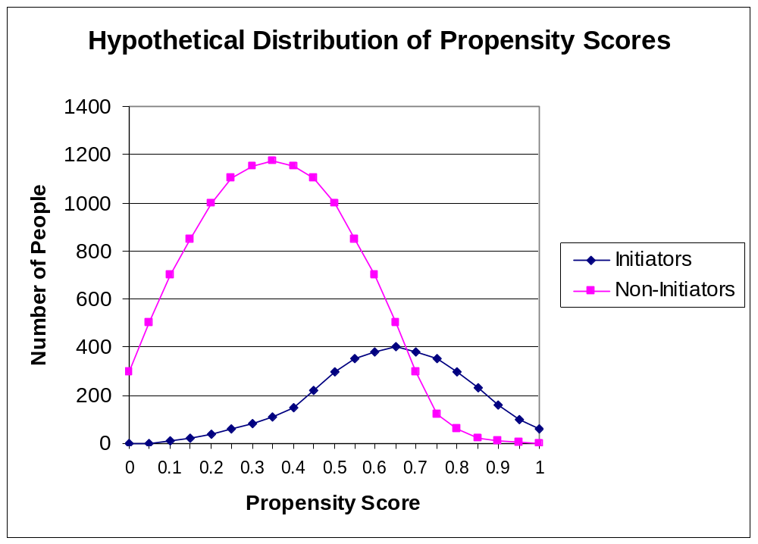
Expected propensity distributions?
Treated
Untreated

Slide 12
What is “treated against expectation?”
Treated
Untreated

Slide 13
“Treated against expectation”
Patient is treated – but has low propensity score
  Patient different from other treated patients
  Some possibilities
    Patient treated for alternate indication (off-label)
    Patient treated as last resort
    Patient treated in error
    Characteristic not captured in PS determines treatment
Patient is untreated – but has high propensity score
  Seemingly “ideal candidate” for treatment
  Some possibilities
    Patient has contraindication (e.g. allergy)
    Patient refuses treatment
    Patient un-treated in error
    Characteristic not captured in PS determines non-treatment

Slide 14
Some PS distributions: what would you do?
%
A
A Extensive selection of treatment
B Moderate selection of treatment
C Little preference for treatment
0
0
0.5
1
%
%
B
C
0
0
0
0.5
1
0
0.5
1
Notes:
14

Slide 15
Why Use Propensity Scores?
Rare outcomes and many confounders (clear advantage)
Explicit modeling of indications for use
Area of common support is explicit
  Modeling may lead to multivariable extrapolation
Matching on PS leads to straight-forward analyses
  Intuitive appeal - easy to see balance in compared groups
  Piggyback onto readers’ existing RCT assessment skills
Robust to model mis-specification (relative to single-stage)
Natural scale for assessing treatment effect heterogeneity (strength of indication)
Useful for prospective research (outcomes yet to occur)
Offers straight-forward approaches to address unmeasured confounding (sampled data collection/PSC sensitivity analyses)

Slide 16

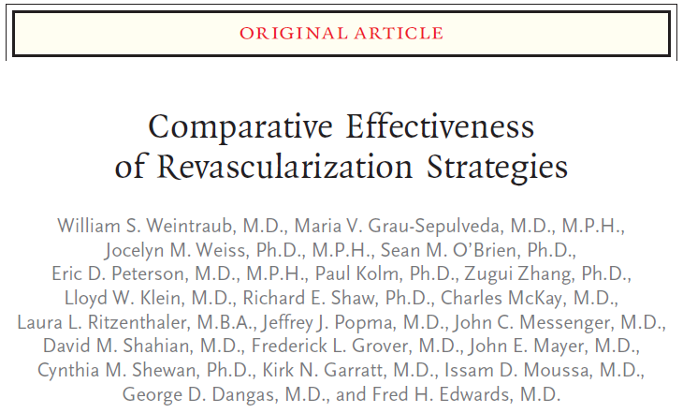

Slide 17
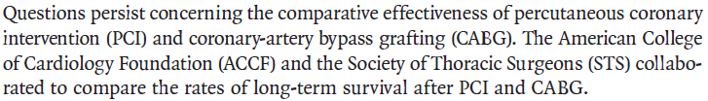
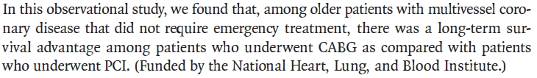

Slide 18
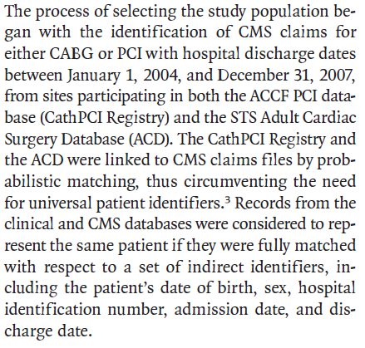
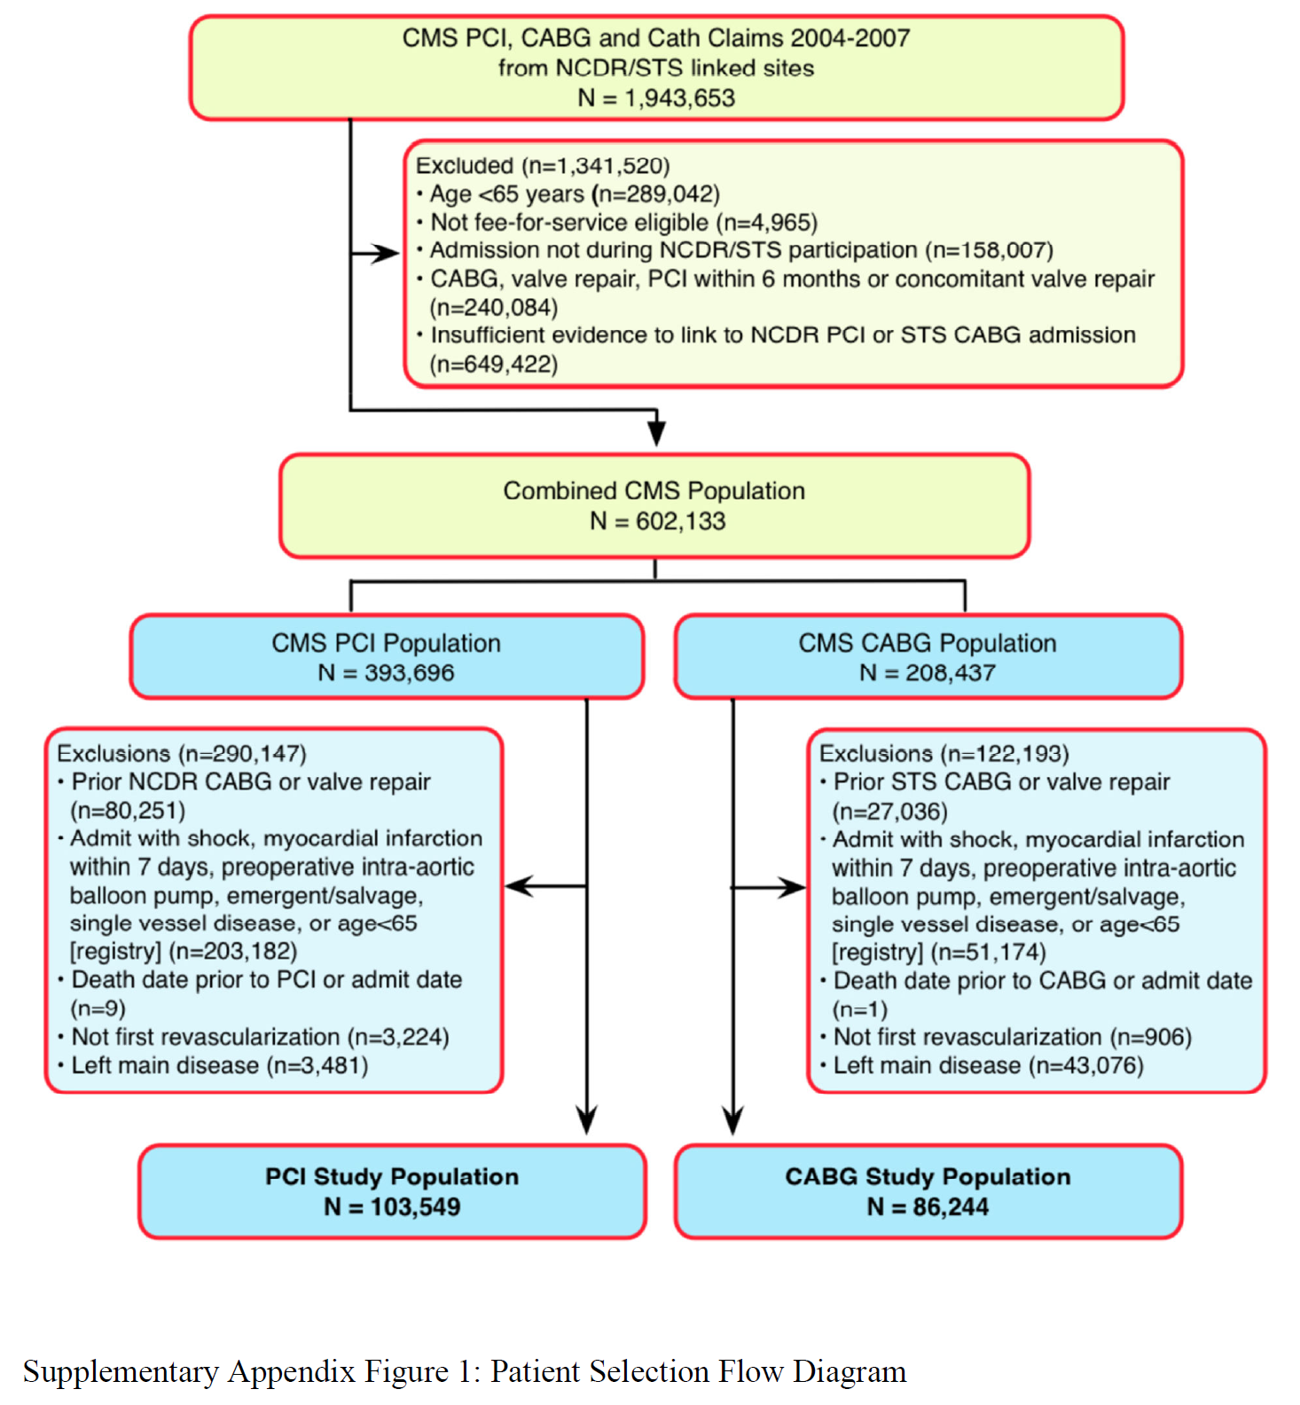
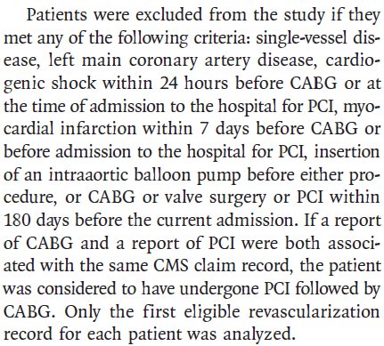

Slide 19
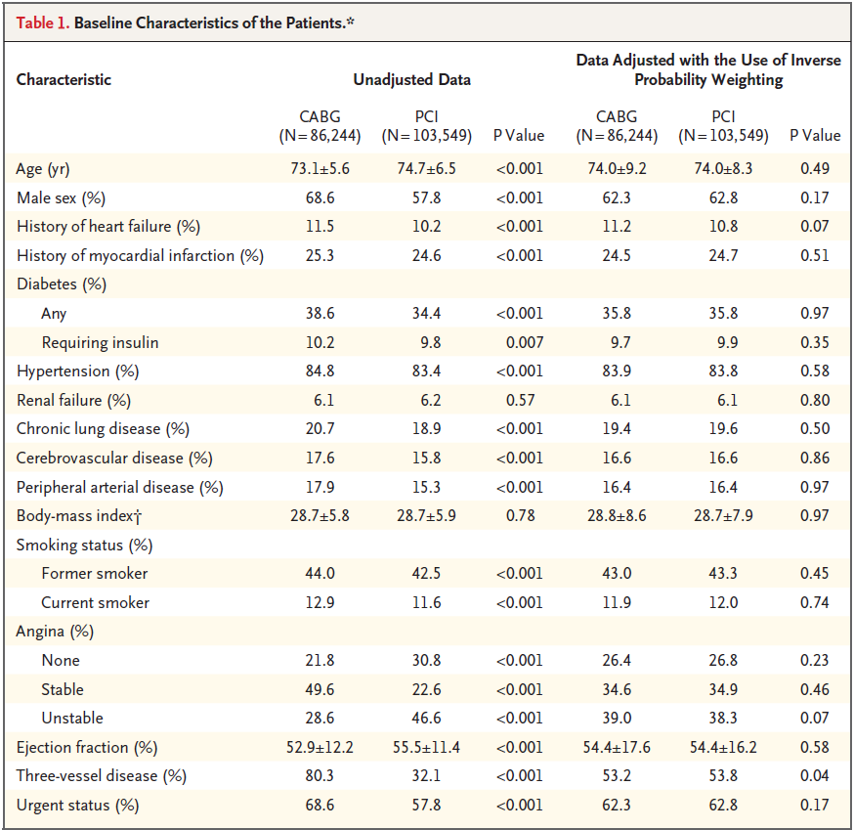

Slide 20
Variables in Propensity Score
Age
Gender
Race
Height
BMI
Smoking
FamHx CAD
GFR (dialysis/GFR≤30)
Renal failure
Hypertension
Dyslipidemia
Cerebrovascular disease
Chronic lung disease
PAD
Heart failure
Prior PCI
Prior MI
Angina
Ejection fraction
Urgent procedure
# vessels
Mitral insuff.
Mitral stenosis
Aortic valve insuff.
Aortic stenosis
Hosp PCI vol
Hosp CABG vol
Academic hosp
Urban/rural
Diabetes

Slide 21
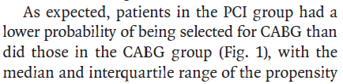
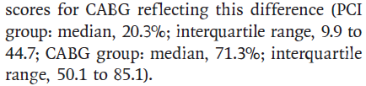
Propensity Score
PS (Predicted probability for CABG)
  CABG 71.3 (IQR: 50.1-85.1)
  PCI 20.3 (IQR: 9.9-44.7)

Slide 22
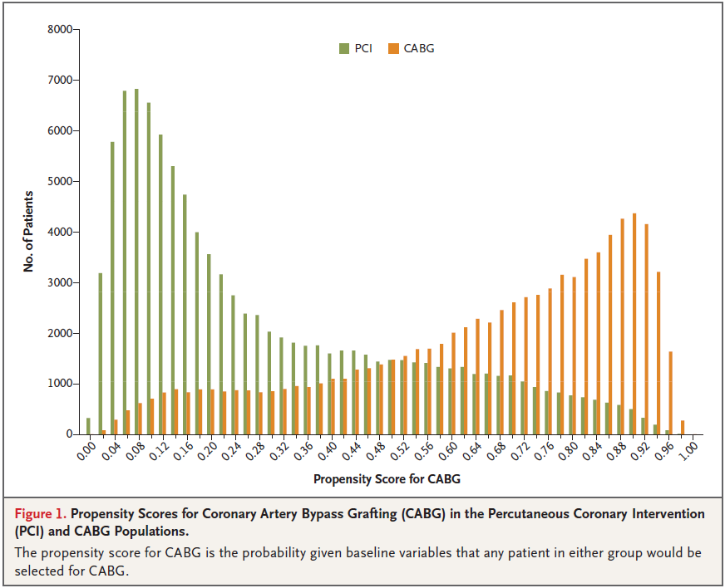

Slide 23
PCI
0.20
CABG
0.71

Slide 25
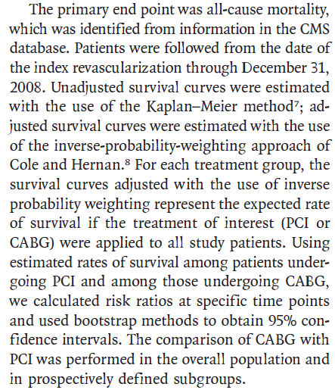
Outcomes

Slide 26
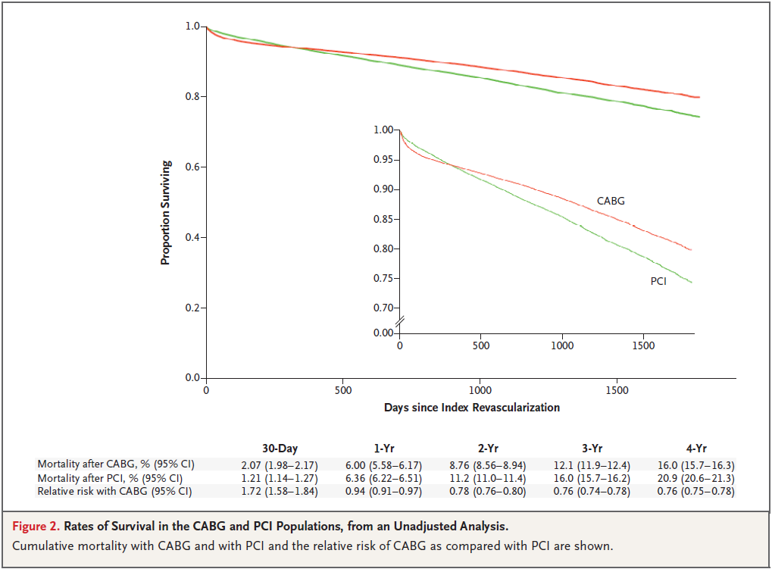

Slide 27
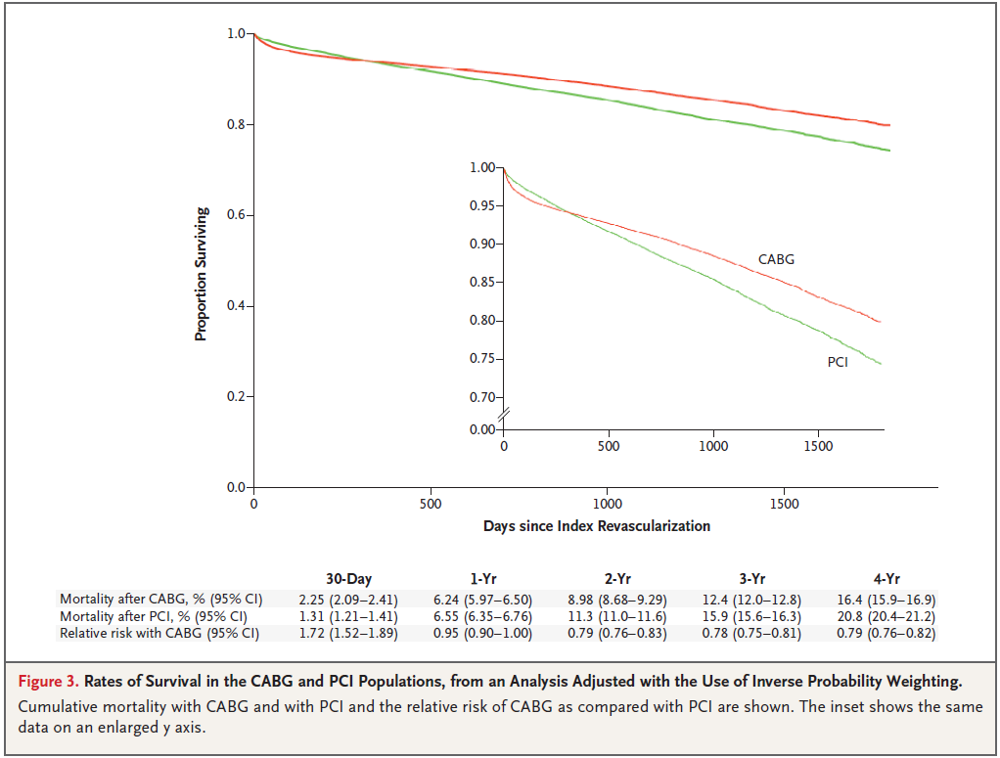

Slide 28
Not in PS Model
Calendar time not included in propensity score
  Study time frame 2004-2007 (4 years)
Allows for patients to be matched (or weighted) across time
Do characteristics have different weights over time?
  Evolution of clinical practice
Follow-up ends at end of 2008 (both CABG and PCI)
Follow-up:
  PCI (median 2.53 years)
  CABG (median 2.83 years)
CABG patients come from 0.3 years (3.6 months) earlier in the study

Slide 29
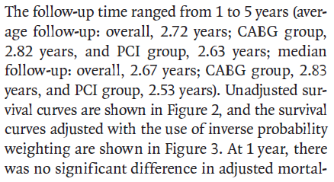
Follow-up
Range: 1-5 yr
Mean
  Overall 2.72 yr
  CABG 2.82 yr
  PCI 2.63 yr
Median
  Overall 2.67 yr
  CABG 2.83 yr
  PCI 2.53 yr
0.3 yr = 3.6 mo
Overall 2.67 yr
CABG 2.83 yr
PCI 2.53 yr
2004
2005
2006
3.6 m
2007
2008
2009

Slide 30
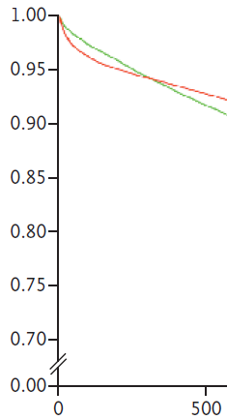
Follow-up Starting 3.6 mo Earlier
30-day PCI mortality
  2004: 1.2%
  2008: 1.2%
30-day CABG mortality
  Premier
  2004: 3.5%
  2010: 2.5%
  Decreases ~0.2% per yr
  0.2%/yr * 0.3 yr = 0.06%
30-day mortality from Weintraub et al.
  CABG: 2.07%
  PCI: 1.21%
  RR: 1.72 (1.58-1.84)
30 Days

Slide 31
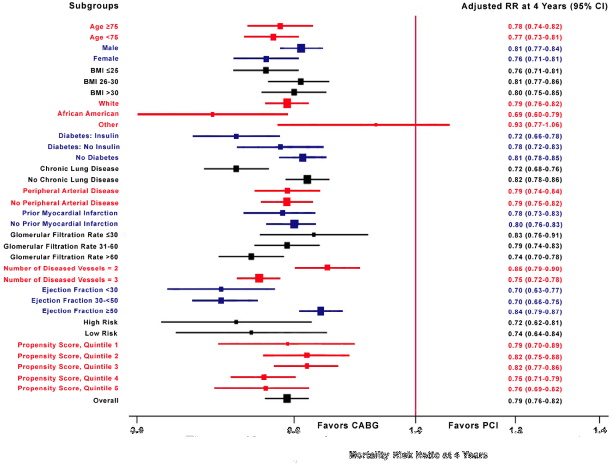
0.69
0.75
0.79
0.82
0.93

Slide 32
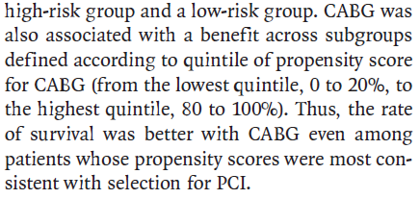
Assessing Heterogeneity of Effect

Slide 33
0.20
0.40
0.60
0.80

Slide 34
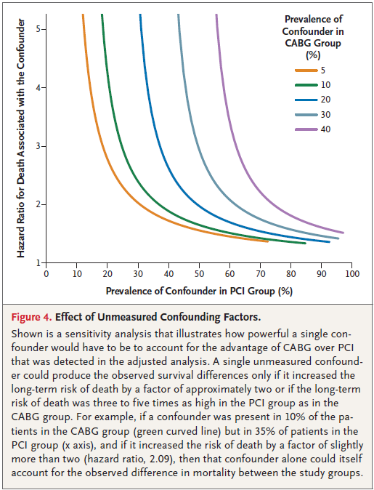
Potential Unmeasured Confounders

Slide 35
Use of the Propensity Score
Restriction
  Trimming
Stratification
Matching
  What algorithm
Modeling
Weighting
  IPTW
  SMR
  Matching

Slide 36
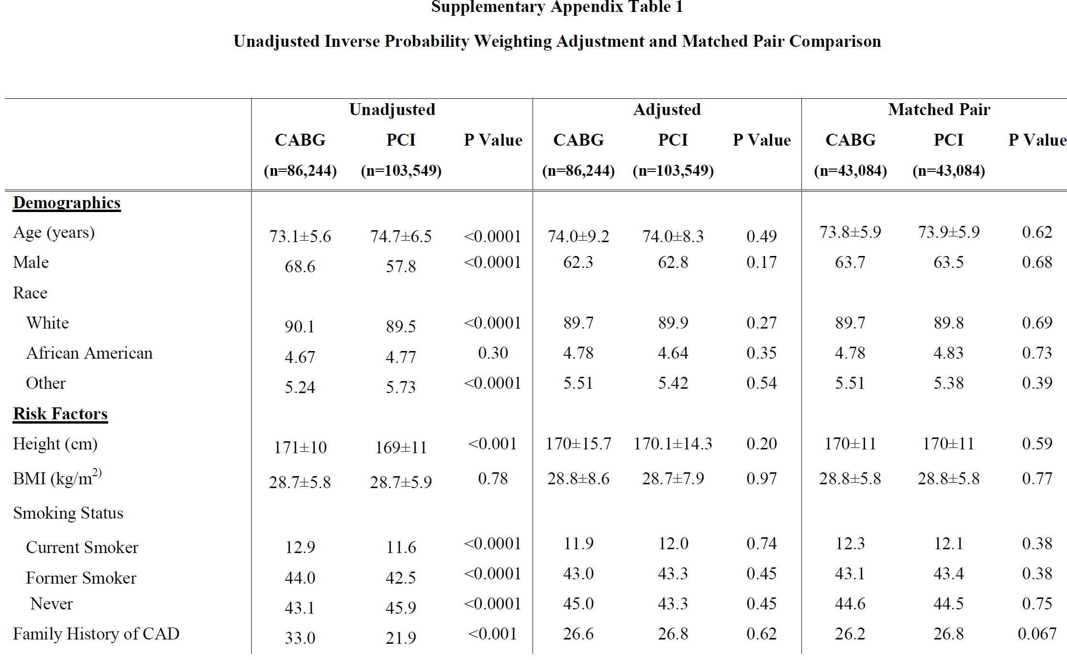

Slide 37
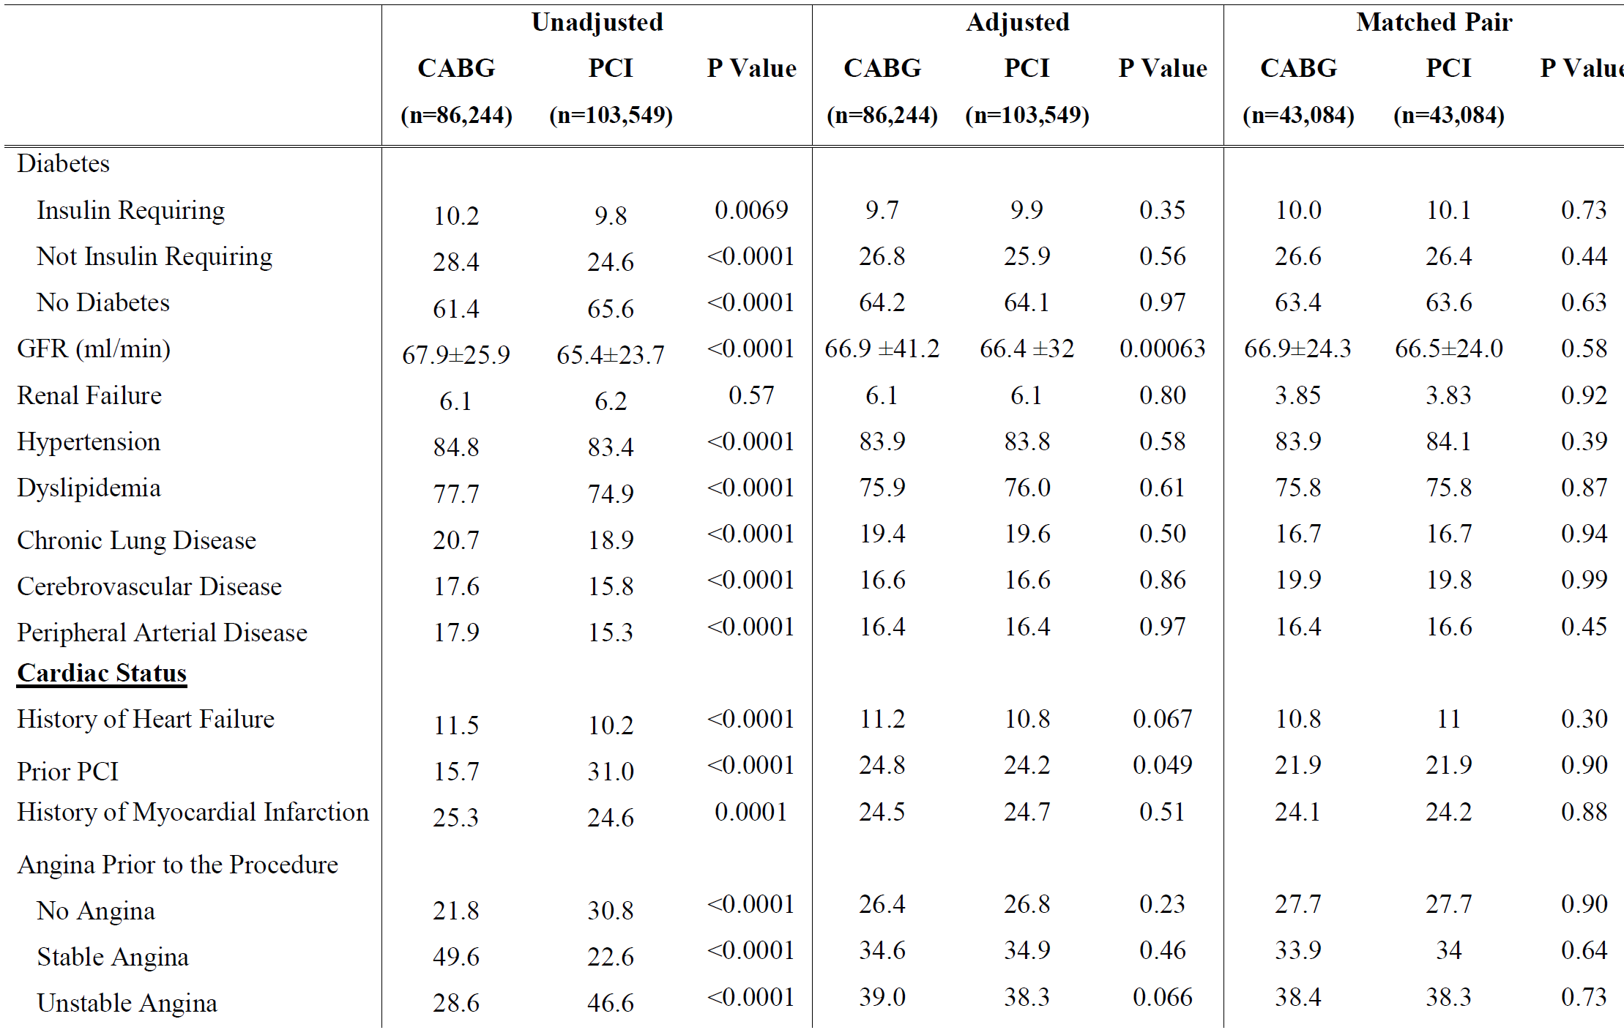

Slide 38
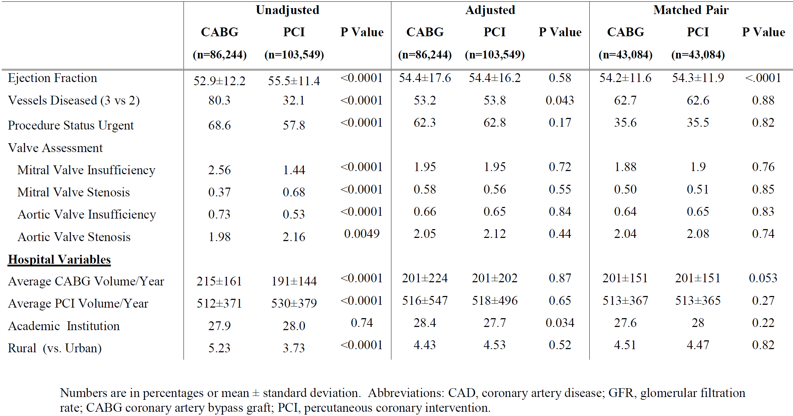

Slide 39
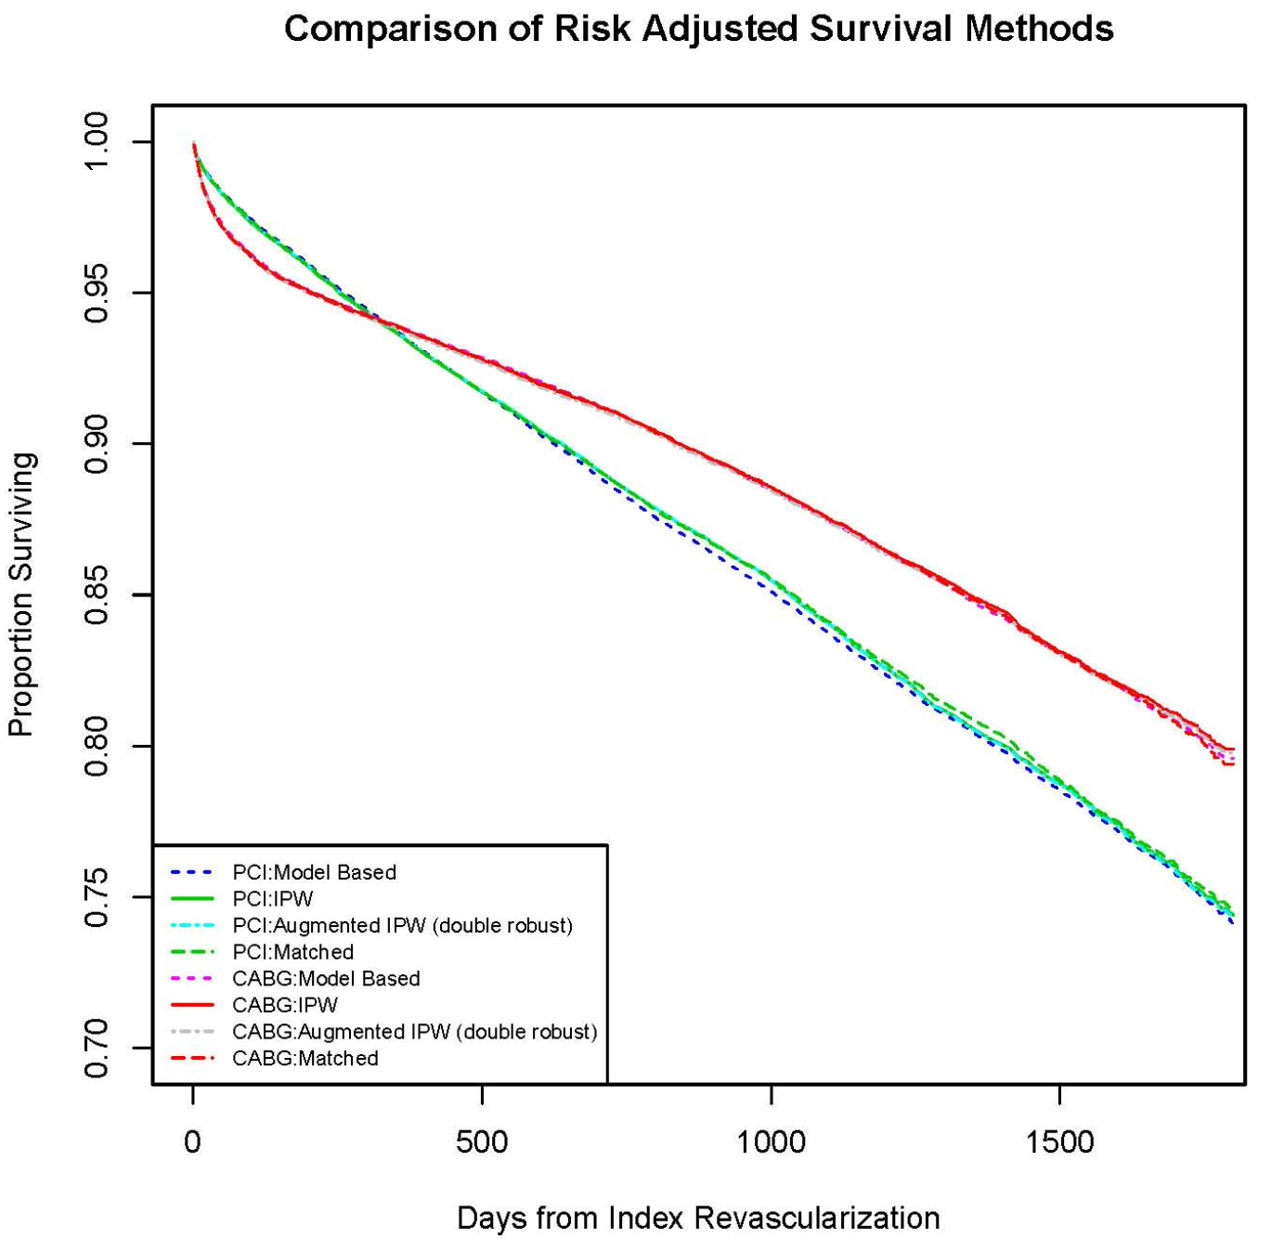

Slide 41
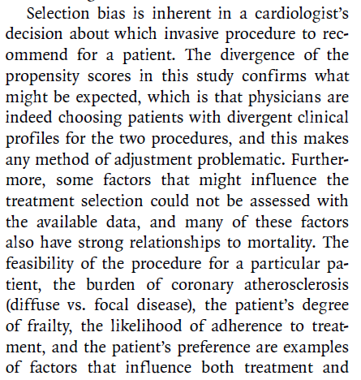
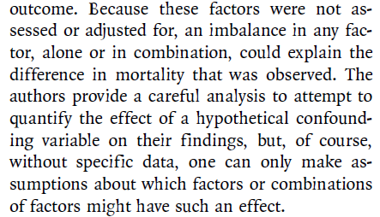
Dr. Mauri’s Comments
Potential Unmeasured Confounders
  Feasibility of procedure
  Burden of atherosclerosis
  Frailty
  Likelihood of adherence
  Patient preference

Slide 42
Journal Club Summary
Start with well-formed question
PS not a single method
  Different use of PS may produce different results
  Conduct the PS analysis different ways (and report)
  Matching/stratification/weighting/modeling/restriction
PS not a panacea
  Unmeasured covariates may not be balanced
    Sensitivity analyses
  Seek enriched data for PS applications
    Linkages with clinical/patient data
  Will not solve a flawed study design
    Improper comparator
    Differential follow-up
    Immortal person-time

Slide 43
Case Study – Statins and MI
Demonstrate statin effectiveness in an observational setting
CV outcome: myocardial infarction (MI)
Rich data source
Propensity score matched cohort design

Slide 44
Propensity Score Considerations
The propensity score can be estimated by building a multivariable regression model that predicts treatment (i.e., the exposure)
In the usual case of dichotomous treatment (treated vs untreated or treatment A vs treatment B), a logistic regression model is most often used

Slide 45
Propensity Score Model
More generalized models are available for categorical, ordinal, or continuous exposures
Propensity score analyses control for factors that are included in the propensity score model
The selection of variables to be included in the propensity score model involves both predictors of treatment and risk factors for the outcome
  All need to be pre-treatment variables since controlling for a consequence of treatment would introduce a bias
Also consider potential interaction between predictors of treatment

Slide 46
Propensity Score Model, cont.
A first set of variables that might be candidates for inclusion would include the “usual suspects”
  Age, gender, and time factors
Indications and contraindications for the therapy should be considered for inclusion
Risk factors for the outcome might next be considered
In administrative data sets, variables that indicate:
  health care utilization
    counts of numbers of drugs dispensed or number of visits to a physician
  Infrastructure variables
    admission mode if hospitalized, time from symptoms to treatment
  Region variables (carefully)
  Socioeconomics

Slide 47
Propensity Score Model, cont.
Empiric approach to variable selection:
  Inclusion of variables that predict treatment
    Such as odds ratio, c-statistic
  Even if unknown mechanism
  Consider also bias formula (Bross, 1966)
Include all available variables (full kitchen sink model)
Modeling constraints limit the number of variables
  1/8 - 1/10 as patients who receive therapy
Data on missing variables can be obtained from a sample of study subjects, or from an outside reference population

Slide 48
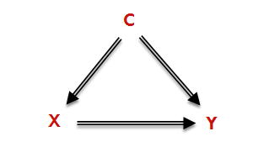

Bias Formula (Bross, 1966)
Determine how much each variable can bias the exposure-outcome (or X-Y) association
Order variables according to bias ranking
Choose top N variables

Slide 49
Propensity Score Model Evaluation
Discrimination of the propensity score model may be measured by the area under the receiver operating characteristics (ROC) curve or c-statistic
Probability that two subjects, drawn at random (one treated, one comparator), will be correctly identified as treated or comparator according to the model
Ranges between 0.5, indicating a model that performs no better than chance at discriminating treatment and 1.0, a model that always correctly distinguishes subjects receiving treatment from comparators
Higher c-statistic indicates more discrimination
  Not necessarily better!
Consider balance metrics

Slide 50
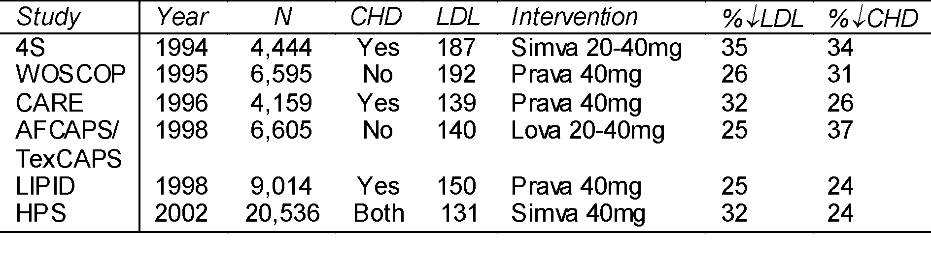
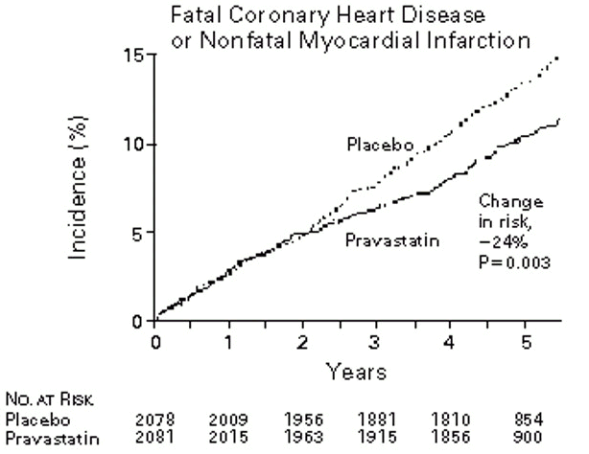
Statins and MI: RCT Results

Slide 51
Data Source
Fallon Community Health Plan
Central Massachusetts HMO
~200,000 members
Claims Data available on:
  Enrollment (age, sex, date)
  Ambulatory care visits
  Hospitalization
  Pharmacy dispensings (drug & quantity)
  Laboratory tests (tests & results)

Slide 52
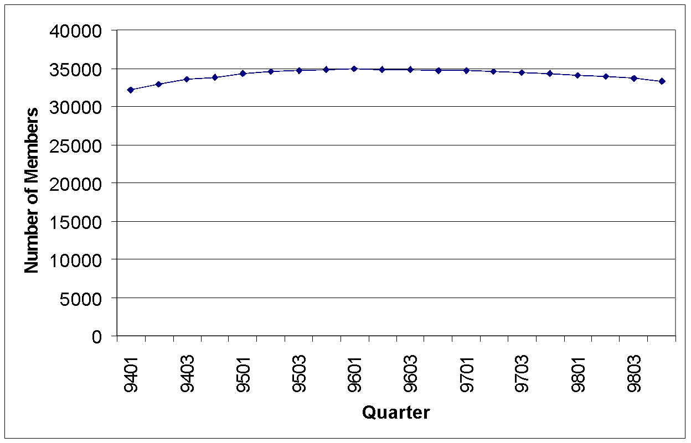
Data from Fallon (Members with LDL>130)

Slide 53
Schematic Representation of Study
Fallon members with any LDL > 130 mg/dl
1993
1994
1995
1996
1997
1998
1999
~35,000
Members
Index date (statin dispensing or random visit)
Apply eligibility criteria
  Member ≥ 1 year
  LDL, HDL, TG in 6 months
  ≥ 1 physician visit in block
  No PAD dx
  Not current statin user
Estimate propensity score (statin initiation)
  Unconditional logistic regression
Match statin initiators with non-initiators
  Within 0.01
Repeat for all blocks of time
Follow matched cohorts for incident MI
Require 1 year
Enrollment
1 of 9 Blocks
2nd/94

Slide 54
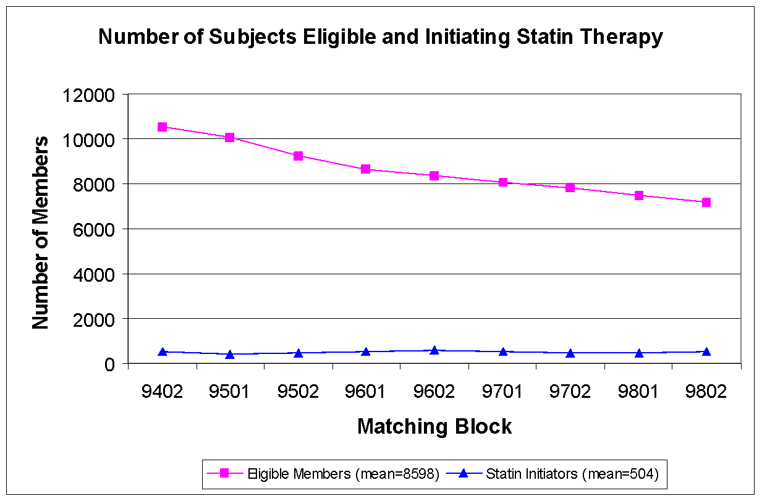

Slide 55
Guidelines, Clinical Practice: Patient Selection
Risk Category
LDL to Initiate
LDL Goal of
Drug Tx
Drug Tx
No CHD and
≥
<160
190
<2 Risk Factors
No CHD and
≥
<130
160
≥
2 Risk Factors
With CHD
>130
≤
100
+Risk Factors: age (45M, 55F), diabetes, smoking, HTN, low HDL,
family history of premature CHD
-Risk Factor: high HDL
NCEP ATP II guidelines (1993)

Slide 56
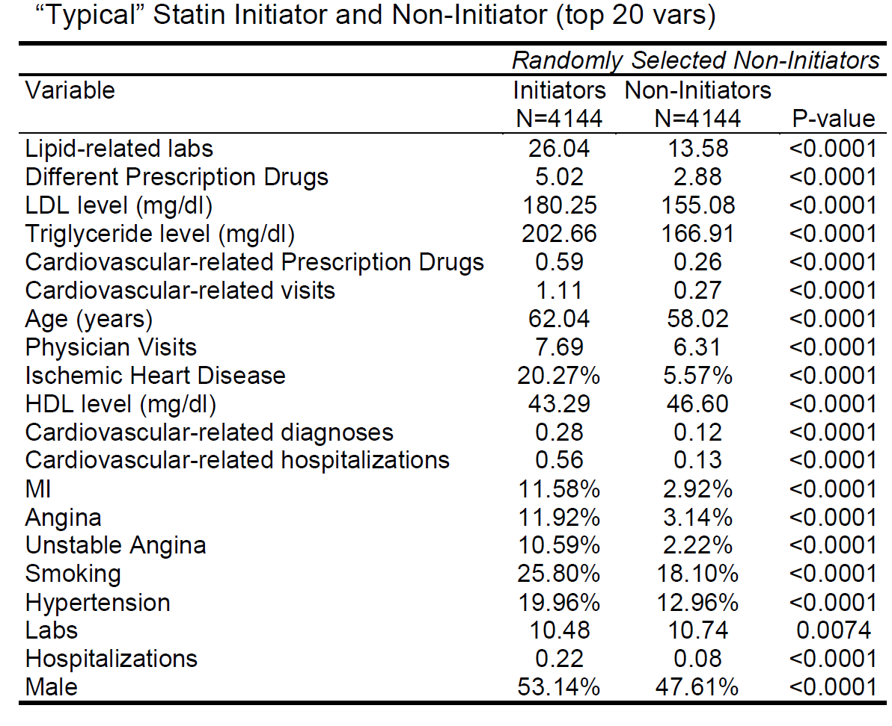

Slide 57
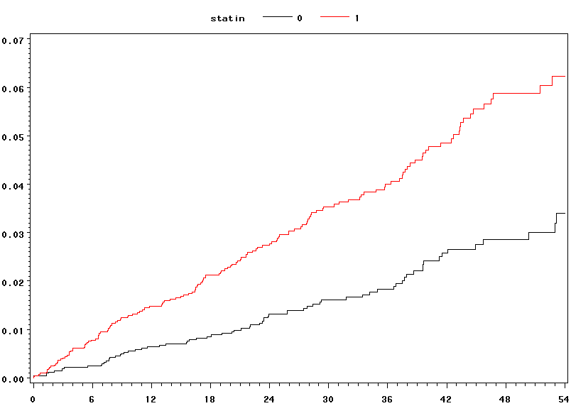

MI Outcome (Unmatched)
HR=2.11 (1.46-3.04)
111% (46%-204%)
Risk Increase
Cumulative Incidence
Statin Initiators
Statin Non-Initiators
Months of Follow-Up

Slide 58
Propensity score estimation
Within each matching block
  Choose a date
    For statin initiators: date of first dispensing
    For statin non-initiators: date of random MD visit
  Fix time-varying covariates as of date
  Predict treatment
    Statin Initiation vs Not
Estimate propensity score from covariates
  Unconditional logistic regression
  Output estimated probabilities – propensity scores

Slide 59
Derivation of Propensity Score
*** develop propensity score for 1/95;
proc logistic descending data=eligible;
model init9501=age9501 male smok obes
days9501 day29501
ang9501
usa9501 chf9501 isch9501 ath9501
cva9501 usa9501 mi9501 olmi9501
htn9501 tia9501 afib9501
ascv9501 hth9501 ost9501
cvs9501 htdx9501 circ9501 cond9501
rvsc9501 hhd9501 dysr9501
lres9501 tres9501 hres9501 hbac9501
hrt9501 ns9501 ins9501 cvhp9501
diab9501 ekg9501 cvrx9501 cvvs9501
llab9501 lab9501 llb29501 cvdg9501
nsca9501 skca9501
depr9501 adj9501 schz9501
deb9501 rh9501
hosp9501 rx9501 vist9501 diag9501
lxl9501 aga9501 rx29501 hp29501/outroc=roc9501;
where elig9501=1;
output out=elignew(keep=id scor9501) predicted=scor9501;
run;
data eligible;
merge eligible elignew;
by id;
run;

Slide 60
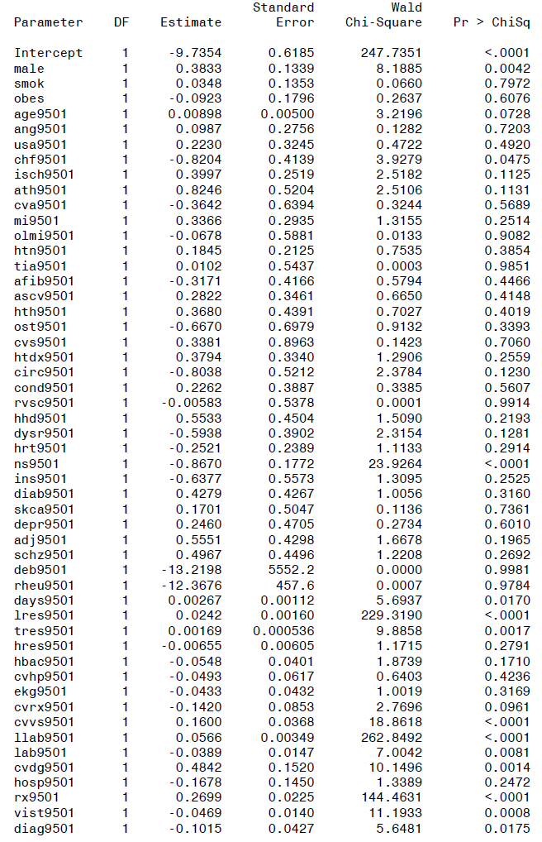

Slide 61
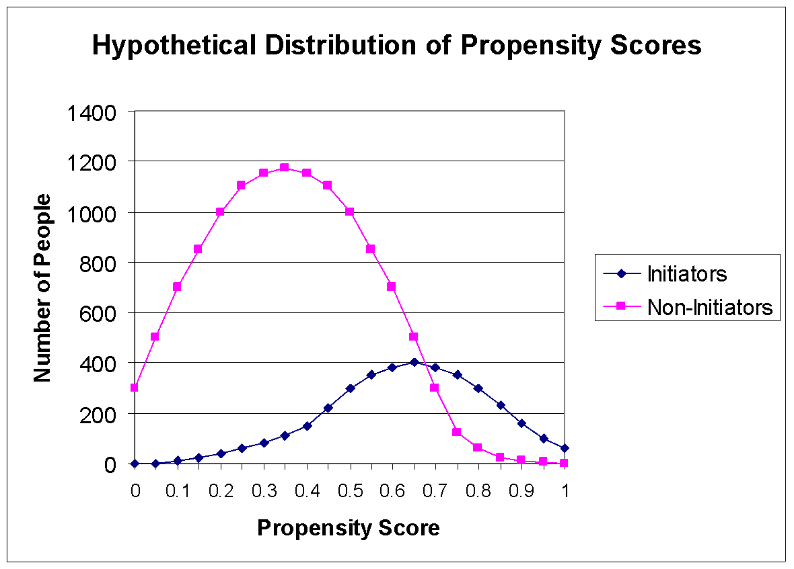

Slide 62
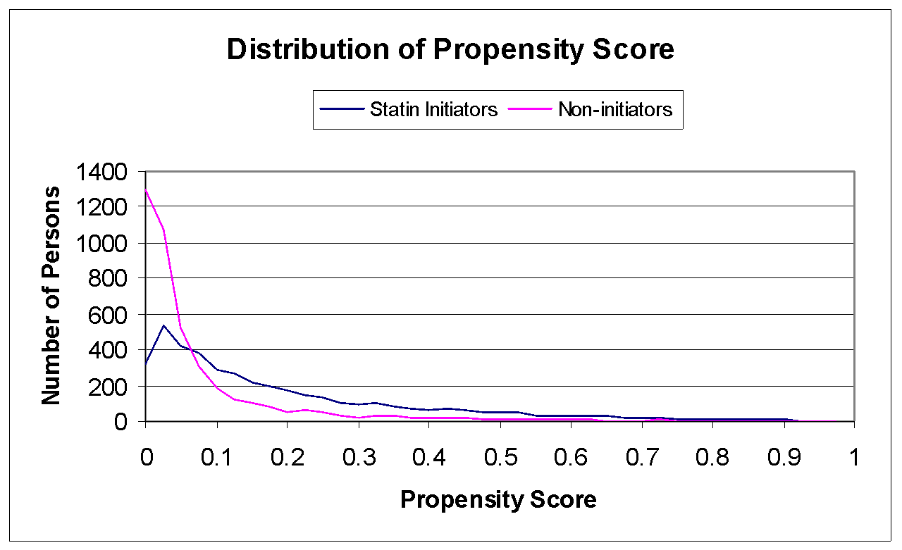

Slide 63
Considerations
Coefficients are Interpretable and Informative
Continuous Predictors Require Care
Interactions – how?
Choice of Predictors Need Not be A-Priori

Slide 64
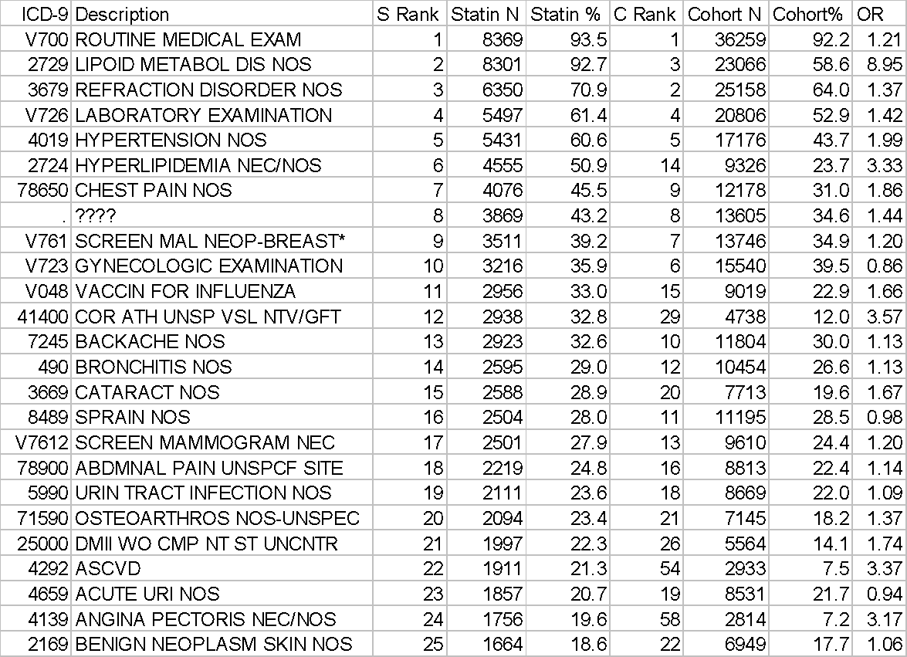

Slide 65
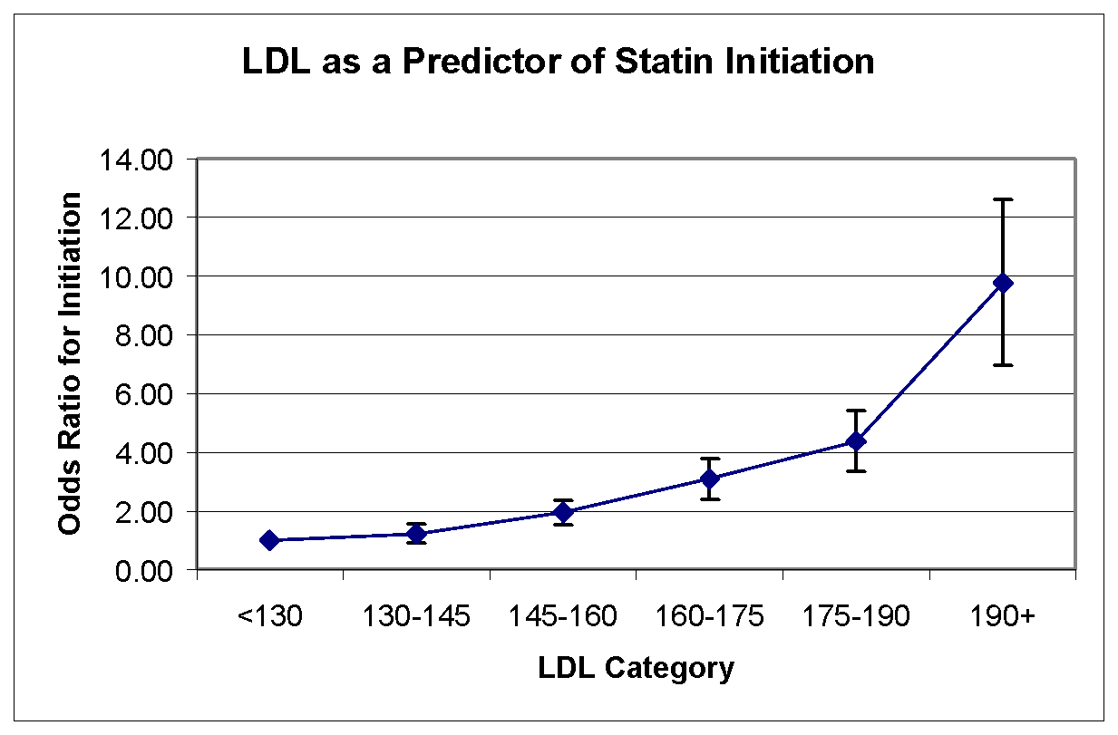

Slide 66
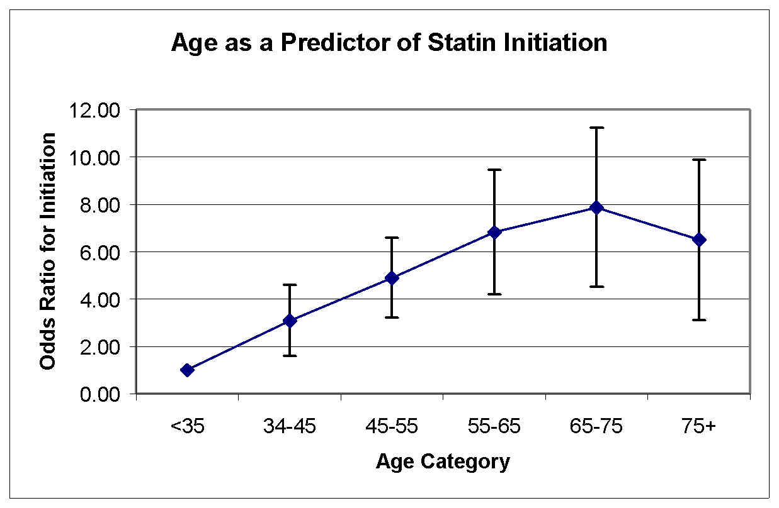

Slide 67
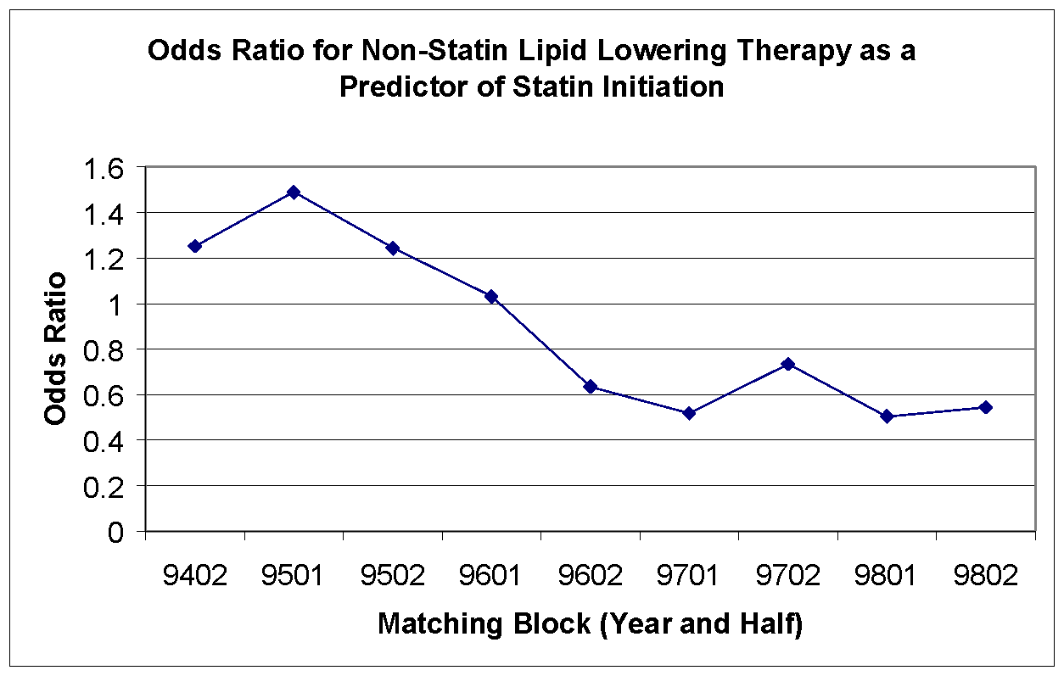

Slide 68
Considerations
Coefficients are Interpretable and Informative
Continuous Predictors Require Care
Interactions – how?
Choice of Predictors Need Not be A-Priori

Slide 69
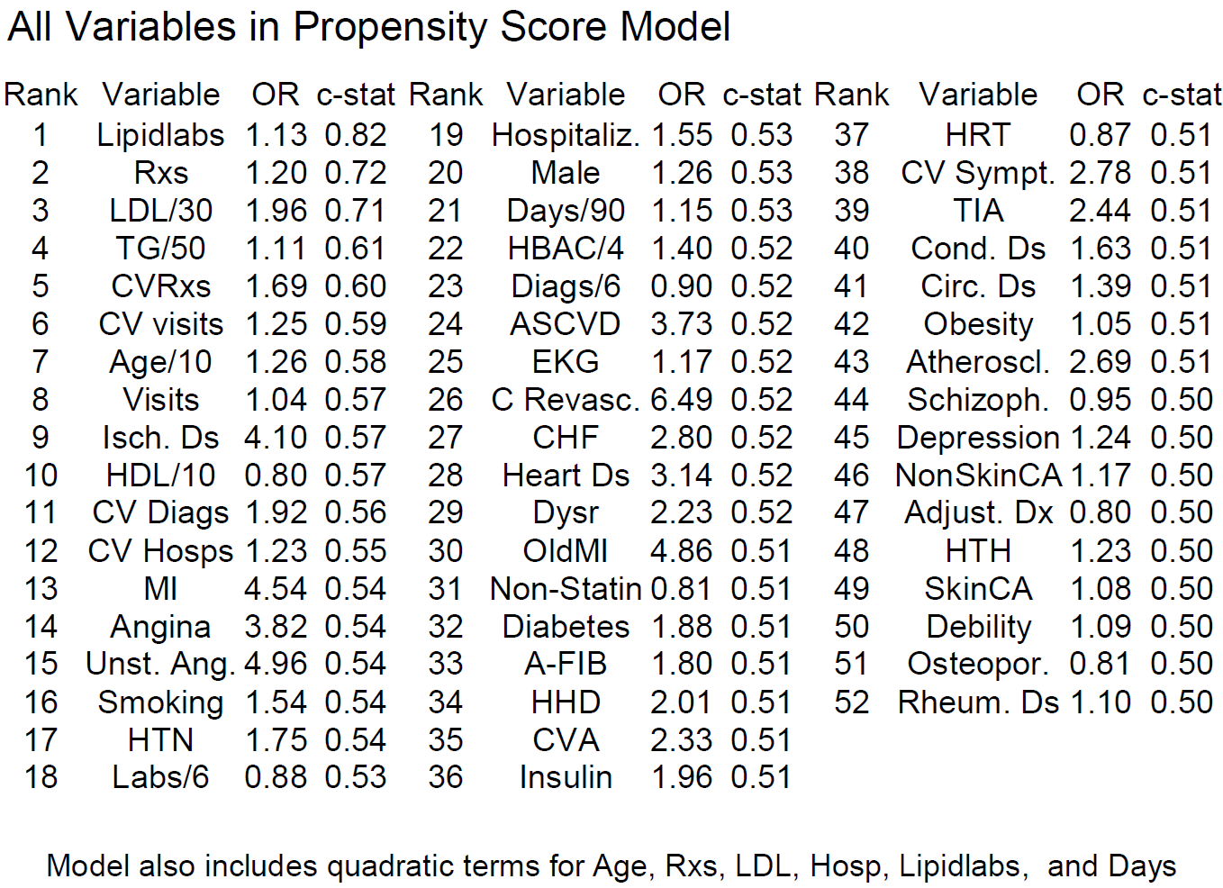

Slide 70
Matching Process
Within each matching block
  Create 2 files: statin initiators & non-initiators
  Choose a statin initiator
    Randomly sort the initiators
    Choose sequentially without replacement
  Match to a non-initiator
    Randomly sort non-initiators
    Cycle through non-initiators
    Choose first with p-score within 0.01 of initiator
    Output matched pair to new file
    If no matches, discard statin initiator

Slide 71
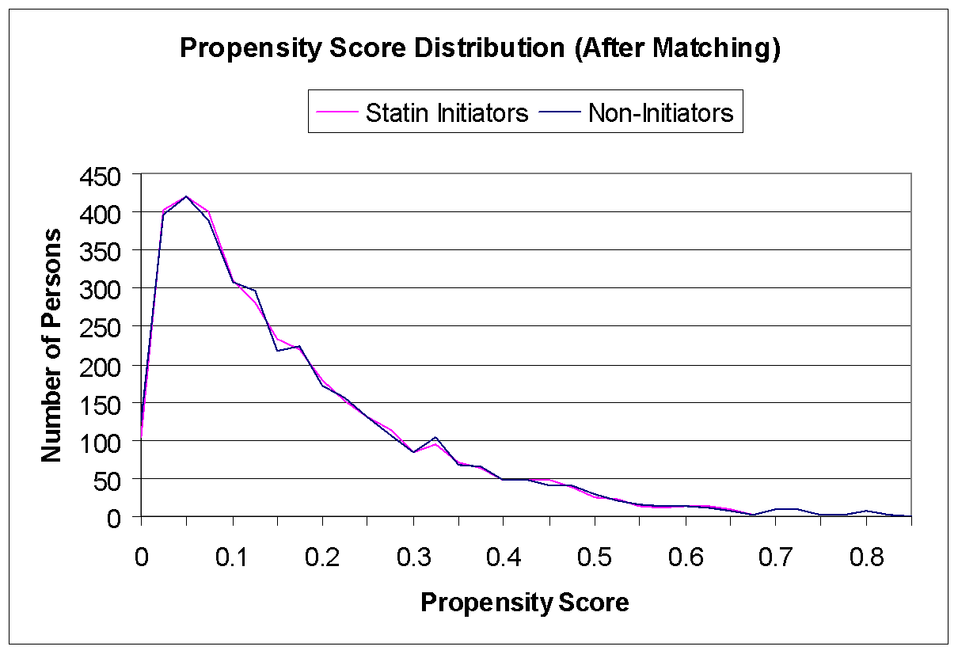

Slide 73
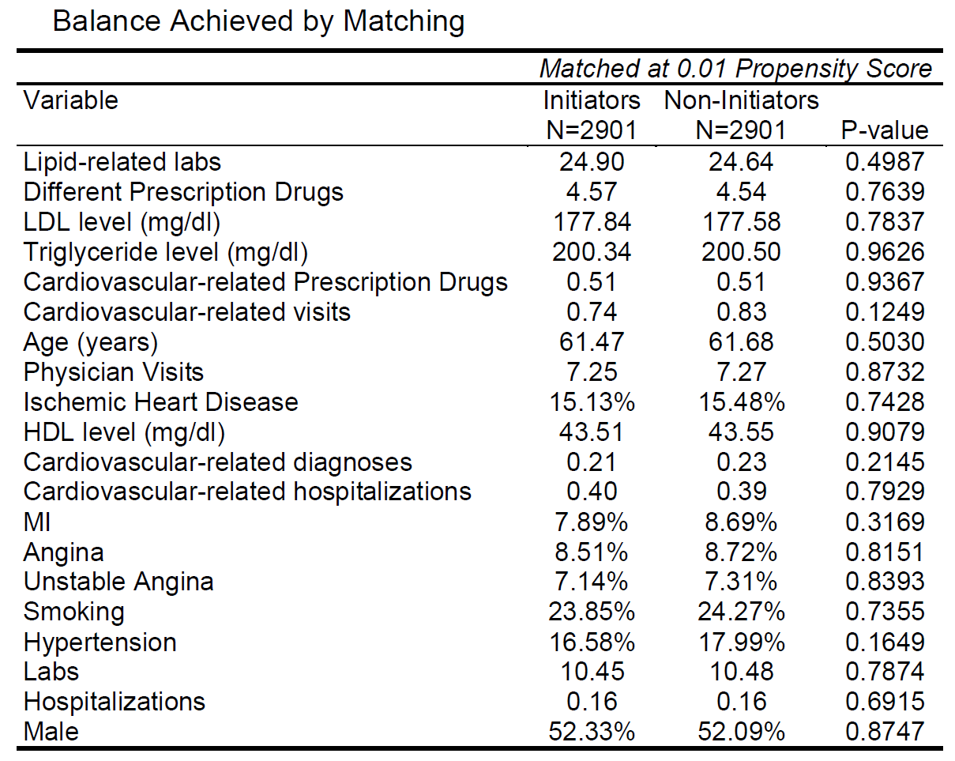

Slide 74
Outcome analysis
Analysis can be viewed as the pooled analysis of 9 separate cohort studies each with ~300 exposed and ~300 unexposed
Or, analysis based on matched pairs: 2901 matched pairs
PH regression stratified on matching block or matched pair

Slide 75
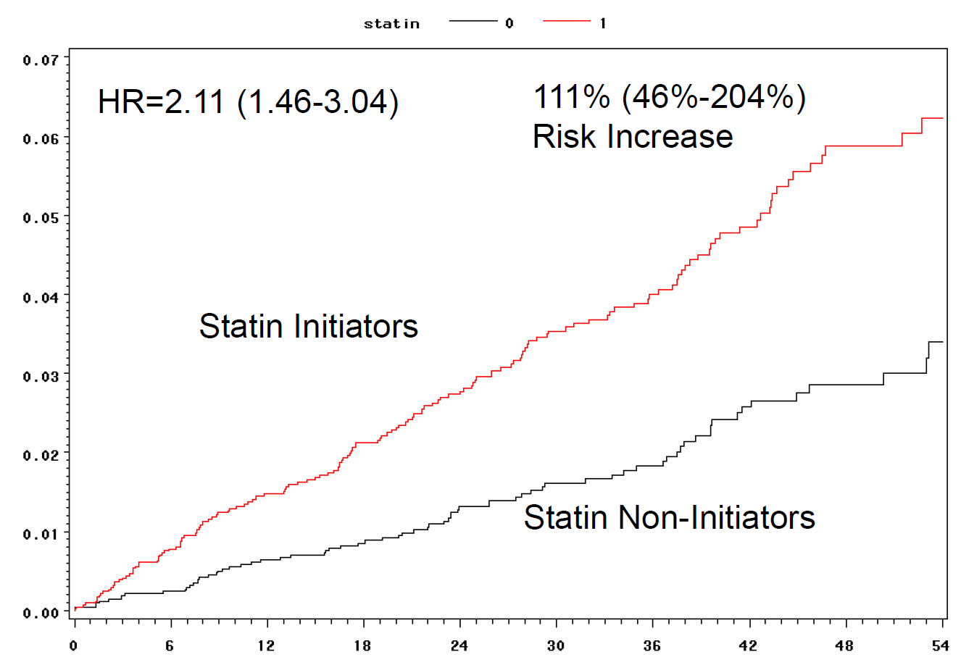

Slide 76
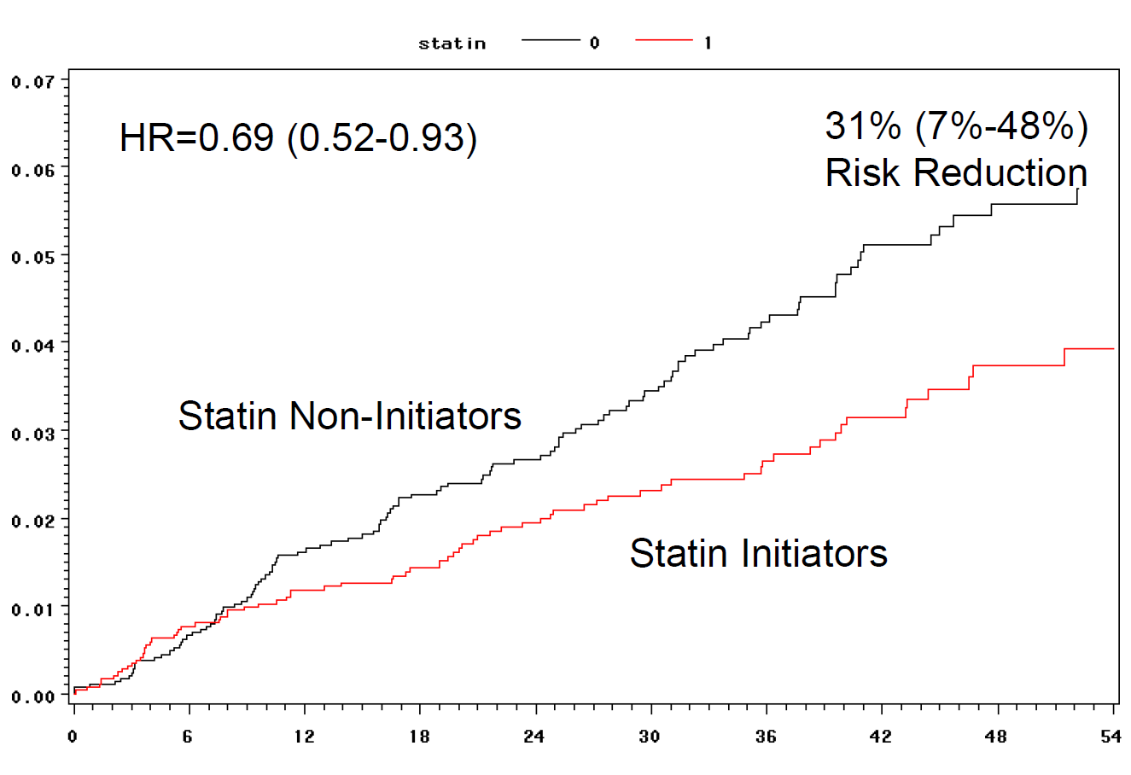

Slide 77
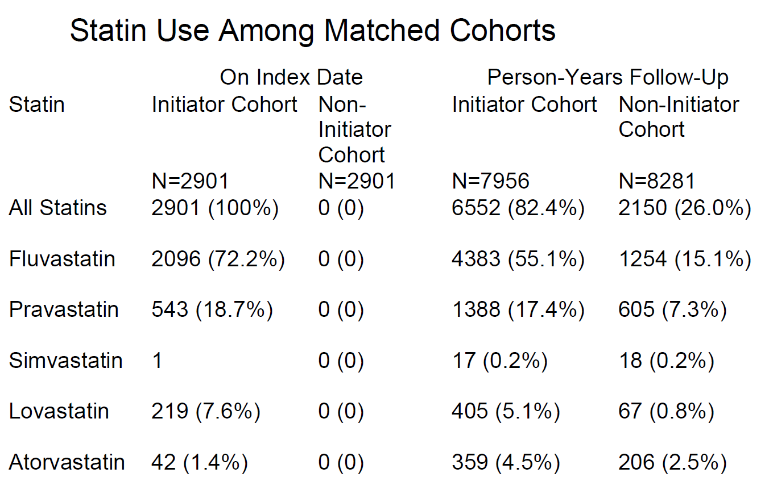

Slide 78
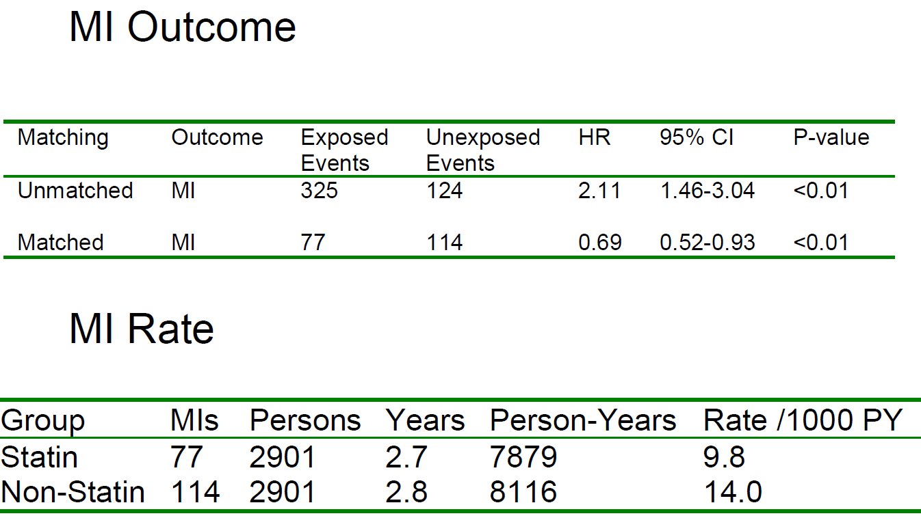

Slide 79
Lessons
Propensity matched cohorts – clinical trial paradigm
  But is not a randomized trial
Well suited to pharmacoepidemiology in claims data
  Rich data – clinical covariates and utilization
  Frequently rare outcomes
Exhaustively identify variables
  A-priori / empiric / utilization / expert opinion
Unadjusted comparisons for outcomes
  Cohorts can be used for multiple outcomes
Conduct study in blocks
  Periodic reporting
  Adjust for changes in practice over time

Slide 80
Propensity and Unmeasured Confounding
Propensity score matching can
  Achieve balance on component variables
But propensity score matching,
  May not achieve balance on variables not included
How do we know when we are done?
  A-priori
  Empiric
  Healthcare utilization
  Clinical trial results
  Expert opinion
Sensitivity analyses
Supplemental data collection

